Slide 1
E-Scooter Rental Database Management
Mini Project
21CSC205P -Database Management Systems
Presented By
RA2211003011035 -Makadia Yakshkumar Vijaykumar
RA2211003011063 - Vishv Patel
Guide
Dr.M.Kandan
Assistant Professor
Dept of CTech

Slide 2
Problem understanding, Identification of Entity and Relationships, Construction of DB using ER Model for the project
Problem understanding
With rising urban demographics and people often travelling or migrating to a new city centre face a problem of availability of viable transport facility, even robust public transport infrastructure does not provide the freedom associated with having personal vehicle, many times this facility is luxury or this choice does not make sense where duration of stay is short.To address this problem, we need to make available a robust, fair and economically sound system such that the costumer feels satisfied with the service he/she receives and also supply side has initiative to maintain providing service.

Slide 3
Identification of Entity and Relationships
It has name of company, number of vehicles rented and registration-id of company.
Registration-id is the primary key
User Entity:
It has UserId, phone no, name, age and DOB. Name is composite attribute of
firstname and lastname. Phone no is multi valued attribute. UserId is the Primary Key
for user entity.
Scooter Entity:
It has scooter-id, price, location, service-due . Scooter-id is the primary key for
scooter entity.
Ledger Entity:
It has transaction-id, rented-at, returned-at. Transaction-id is the primary key for
ledger entity.

Slide 4
RentingStation Entity:
It has stationid, avail_scooter, address,number. Transaction-id is the primary
key for ledger entity.
City Entity:
It has name. Name is the primary key.
Relationships between Entities: example given below
Is-in:
Is-in relationship demonstrate the presence of a user in following city.
Located-in:
It is used to demonstrate the location of renting station in city.
Have:
It used to show the relation between company and renting-station.
Rented-scooter:
It is used to maintain record of the rented vehilcle.

Slide 5
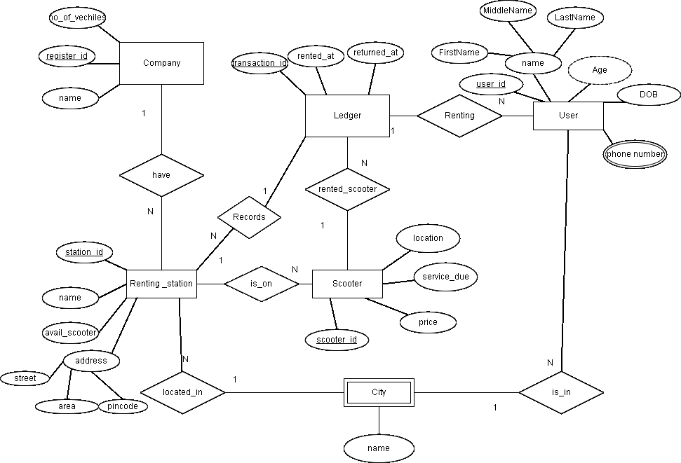
Construction of DB using ER Model for the project

Slide 6
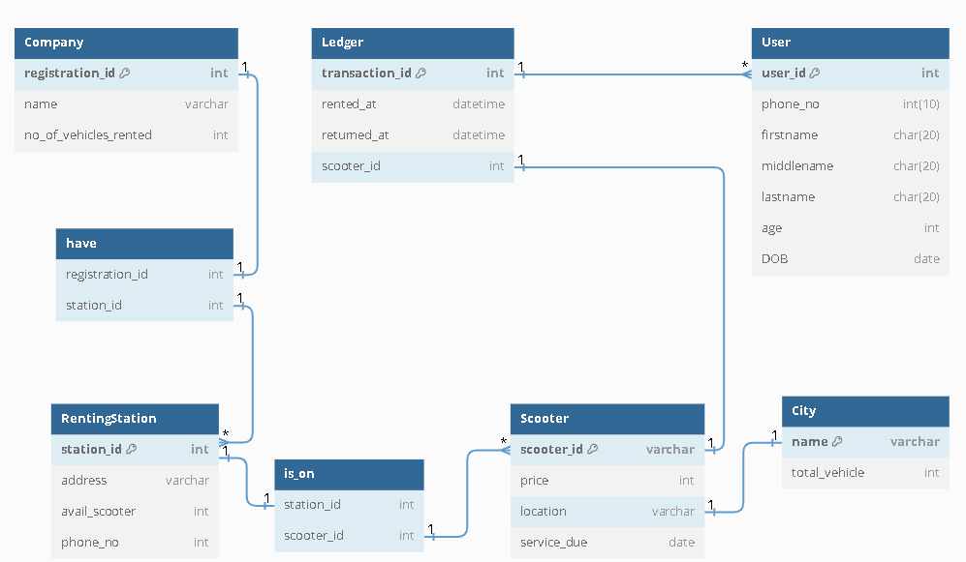
Design of Relational Schemas, Creation of Database Tables for the project

Slide 7
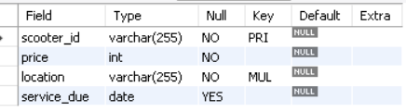
Design of Relational Schemas, Creation of Database Tables for the project (Cont..)
DDL Commands and Results
Create Database Escooter_dbms;
Use Escooter_dbms;
CREATE TABLE Company (
registration_id INT PRIMARY KEY,
name VARCHAR(255) NOT NULL,
no_of_vehicles_rented INT NOT NULL,
UNIQUE (name)
);
Sql>> Desc Scooter;

Slide 8

Design of Relational Schemas, Creation of Database Tables for the project (Cont..)
CREATE TABLE City (
name VARCHAR(255) PRIMARY KEY,
total_vehicle INT NOT NULL
);
CREATE TABLE RentingStation (
station_id INT PRIMARY KEY,
address VARCHAR(255) NOT NULL,
avail_scooter INT NOT NULL,
phone_no BIGINT(10) NOT NULL,
FOREIGN KEY (station_id) REFERENCES Company(registration_id)
);
Sql>> Desc City ;

Slide 9
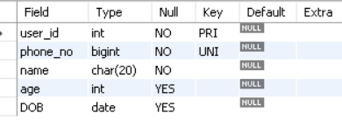
Design of Relational Schemas, Creation of Database Tables for the project (Cont..)
CREATE TABLE User (
user_id INT PRIMARY KEY,
phone_no BIGINT(10) NOT NULL,
name CHAR(20) NOT NULL,
age INT,
DOB DATE,
UNIQUE (phone_no)
);
Sql>> Desc User;

Slide 10
Design of Relational Schemas, Creation of Database Tables for the project (Cont..)
CREATE TABLE Scooter (
scooter_id VARCHAR(255) PRIMARY KEY,
price INT NOT NULL,
location VARCHAR(255) NOT NULL,
service_due DATE,
FOREIGN KEY (location) REFERENCES City(name)
);
Sql>> Desc Scooter;

Slide 11
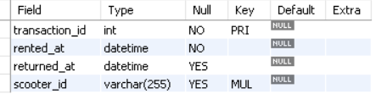
Design of Relational Schemas, Creation of Database Tables for the project (Cont..)
CREATE TABLE Ledger (
transaction_id INT PRIMARY KEY,
rented_at DATETIME NOT NULL,
returned_at DATETIME,
scooter_id VARCHAR(255),
FOREIGN KEY (scooter_id) REFERENCES Scooter(scooter_id),
FOREIGN KEY (transaction_id) REFERENCES User(user_id)
);
Sql>> Desc Ledger ;

Slide 12
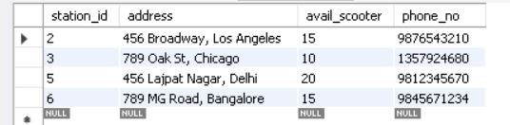
Complex queries based on the concepts of constraints, sets, joins, views, Triggers and Cursors
Complex queries based on the concepts of constraints
Sub-query 1
SELECT *
FROM RentingStation
WHERE avail_scooter < 22
AND station_id IN (SELECT station_id FROM RentingStation WHERE avail_scooter < 22)
AND address NOT IN ('Mumbai', 'New York');

Slide 13
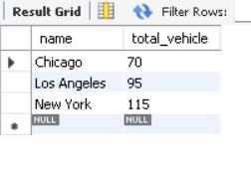
Complex queries based on the concepts of constraints (continued…)
Sub-query 2
UPDATE city
Set total_vehicle = total_vehicle +15
where name <> 'Chicago';
select * from city

Slide 14
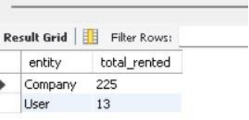
Sets
1)Retrieve the total number of vehicles rented by companies and users
(SELECT 'Company' AS entity, SUM(no_of_vehicles_rented) AS total_rented FROM Company) UNION (SELECT 'User' AS entity, COUNT(*) AS total_rented FROM Ledger);

Slide 15
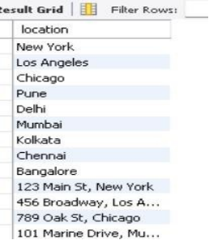
Sets
2)Retrieve distinct locations from Scooter table
(SELECT DISTINCT location FROM Scooter) UNION (SELECT DISTINCT address AS location FROM RentingStation);

Slide 16
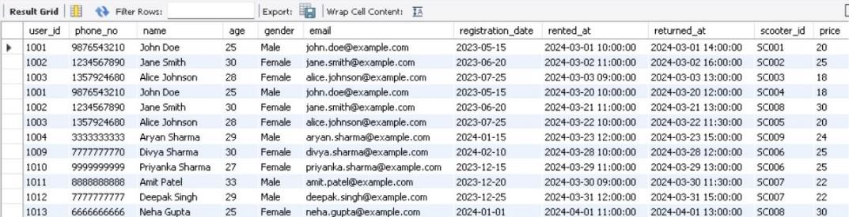
Joins
1)Joining User, Ledger, and Scooter tables to get details of users along with their rented
scooters: SELECT u., l.rented_at, l.returned_at, s.
FROM User u
JOIN Ledger l ON u.user_id = l.user_id
JOIN Scooter s ON l.scooter_id = s.scooter_id;

Slide 17
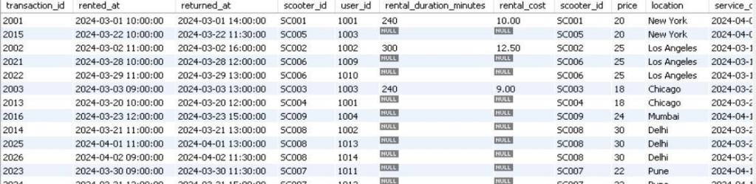
Joins
2)Joining Ledger, Scooter, and RentingStation tables to get details of rented scooters along with their renting stations:
SELECT l., s., rs.address AS renting_station_address FROM Ledger l
JOIN Scooter s ON l.scooter_id = s.scooter_id
JOIN RentingStation rs ON s.renting_station_id = rs.station_id;

Slide 18
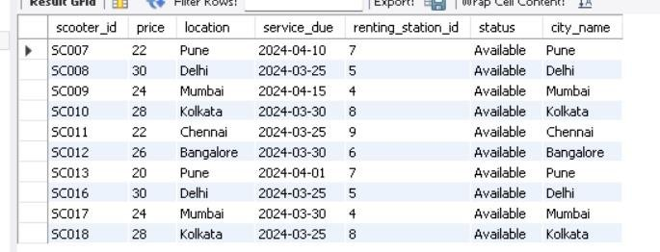
Views
View 1: Scooters in India:
CREATE VIEW Scooters_In_India AS SELECT s.*, c.name AS city_name FROM Scooter s
JOIN City c ON s.location = c.name WHERE c.country = 'India';

Slide 19
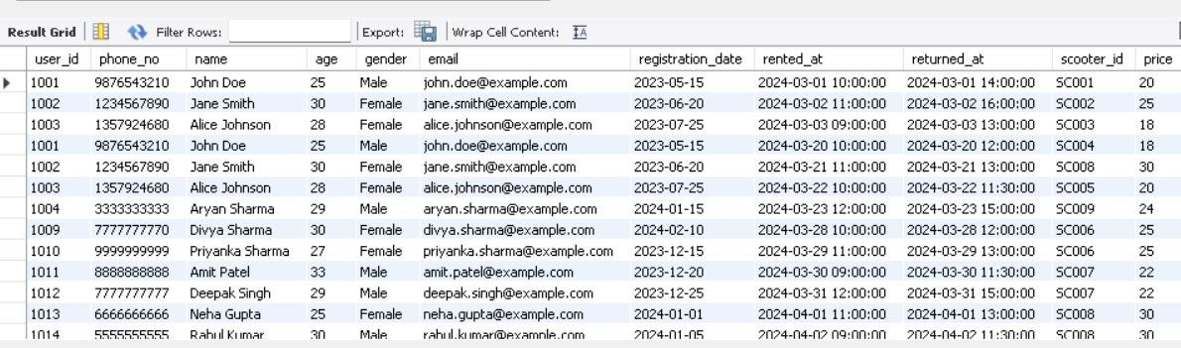
Views
View 2: Users with their renting details:
CREATE VIEW Users_Renting_Details AS SELECT u., l.rented_at, l.returned_at, s.
FROM User u
JOIN Ledger l ON u.user_id = l.user_id
JOIN Scooter s ON l.scooter_id = s.scooter_id;

Slide 20
Triggers
Insert Trigger: Automatically updates the total number of rentals made by a user when a new rental transaction is inserted into the Ledger table.
CREATE TRIGGER Update_Total_Rentals AFTER INSERT ON Ledger
FOR EACH ROW BEGIN
UPDATE User
SET total_rentals = total_rentals + 1 WHERE user_id = NEW.user_id;
END;
Update Trigger: Ensures that the age of a user is updated in the User table when their date of birth (DOB) is modified.
CREATE TRIGGER Update_User_Age AFTER UPDATE ON User
FOR EACH ROW BEGIN
UPDATE User
SET age = TIMESTAMPDIFF(YEAR, NEW.DOB, CURDATE())
WHERE user_id = NEW.user_id; END;

Slide 21
Triggers
Delete Trigger: Automatically updates the total number of scooters available in a city when a scooter is removed from the Scooter table.
CREATE TRIGGER Update_Scooters_Available_Delete AFTER DELETE ON Scooter
FOR EACH ROW BEGIN
UPDATE City
SET total_vehicle = total_vehicle - 1 WHERE name = OLD.location;
END;

Slide 22
Cursors
DELIMITER //
CREATE PROCEDURE GetCities() BEGIN
DECLARE done INT DEFAULT FALSE; DECLARE name_val VARCHAR(255);
DECLARE total_vehicle_val INT; DECLARE region_val VARCHAR(100); DECLARE country_val VARCHAR(100);
DECLARE cur CURSOR FOR SELECT name, total_vehicle, region, country FROM City; DECLARE CONTINUE HANDLER FOR NOT FOUND SET done = TRUE;
OPEN cur; read_loop: LOOP
FETCH cur INTO name_val, total_vehicle_val, region_val, country_val;
IF done THEN LEAVE read_loop;
END IF;

Slide 23

Cursors (continued..)
-- Do whatever you want with the fetched data
-- For example, you can print it
SELECT name_val, total_vehicle_val, region_val, country_val; END LOOP;
CLOSE cur;
END //
DELIMITER ;

Slide 24
Analyzing the pitfalls, identifying the dependencies, and applying normalizations
Redundancy:The current data structure does not exhibit significant redundancy. Each entry appears to be unique, with no duplicated information. However, there may be potential redundancy in storing contact person details separately from the company information. If multiple contact persons are associated with a single company, this approach could lead to redundancy in company details (such as name, address, etc.) being stored for each contact person.
Inefficiency: Storing contact person details separately could lead to inefficiencies, especially when there are many contact persons associated with a single company. Each time a query or update is made to a contact person's details, it would require accessing and potentially modifying multiple records. This could result in increased processing time and complexity.( No significant inefficiency observed in otther table.)
Complexity: The current data structure does not exhibit significant complexity. However, the separation of contact person details from company information adds a layer of complexity to the data management process. Ensuring consistency and integrity between these related entities would require additional effort and could potentially lead to errors if not managed properly.

Slide 25
Analyzing the pitfalls, identifying the dependencies, and applying normalizations (Cont..)
Dependencies in the Data Structure:
- Partial Dependencies: No partial dependencies are evident in the current data structure. Each attribute appears to be fully dependent on the primary key.
- Transitive Dependencies: Similarly, there are no transitive dependencies observed. All non-key attributes seem to be directly dependent on the primary key.
- Multi-valued Dependencies: There are no multi-valued dependencies in the data structure. Each attribute seems to have a single value associated with it.
- Join Dependencies: Join dependencies occur when data can be reconstructed by joining multiple tables. In this case, since there is only one table, join dependencies are not applicable.
Overall, the data structure appears to be in a normalized form, with no evident anomalies related to dependencies. This suggests that the data has been organized efficiently, without redundant or unnecessary dependencies.

Slide 26
Implementation of concurrency control and recovery mechanisms
Atomicity
Atomicity refers to the property of a transaction that ensures that either all operations within the transaction are successfully completed and committed, or none of them are.
Implementation: In the provided code, transactions are used to group operations together. This means that when inserting or updating data, all related operations are wrapped in a transaction. If any part of the transaction fails, the entire transaction is rolled back, ensuring that the database remains in a consistent state.
Example: For example, if a transaction involves inserting data into multiple tables, either all inserts are successful and committed, or none of them are. This ensures that the database is not left in a partially updated state due to a failure in one part of the transaction.

Slide 27
Consistency
Consistency ensures that the database remains in a valid state before and after the transaction.
Implementation: The code enforces consistency through the use of database constraints, such as foreign key constraints and unique constraints. These constraints define rules about the relationships between tables and the uniqueness of data values, ensuring that data integrity is maintained.
Example: For instance, a foreign key constraint ensures that a value in one table must match a value in another table's primary key, maintaining the relationship between the tables and preventing inconsistencies.

Slide 28
Isolation
Isolation ensures that transactions are executed independently of each other, without interference.
Implementation: Transactions in the code are executed in isolation, meaning that changes made by one transaction are not visible to other transactions until the changes are committed. This prevents concurrent transactions from interfering with each other.
Example: If two transactions are trying to update the same data simultaneously, isolation ensures that each transaction sees the data as it was before the other transaction made its changes, preventing conflicts and maintaining data integrity.

Slide 29
Durability
Durability ensures that once a transaction is committed, the changes made by the transaction are permanently saved, even in the event of a system failure.
Implementation: The code ensures durability by using database system's logging and recovery mechanisms. These mechanisms maintain a record of committed transactions, allowing the system to recover data in case of a failure.
Example: For example, if a system crashes after a transaction is committed, the logging mechanism can be used to recover the committed transaction and restore the database to its state before the crash, ensuring that no data is lost.

Slide 30
Result and Discussion
Database Schema Implementation:
The e-scooter rental system successfully implements a relational database schema using MySQL, encompassing entities such as users, scooters, rentals, locations, payments, and feedback.
Data Integrity and Consistency:
The system ensures data integrity and consistency through foreign key relationships, enforcing referential integrity constraints between related tables. This prevents inconsistencies and maintains the integrity of the database.
Efficient E-Scooter Rental Management:
Users can efficiently rent e-scooters through the platform, including locating available scooters, renting them, and making payments. The system also manages scooter availability, location tracking, and maintenance scheduling.

Slide 31
Result and Discussion(continued…)
User-Friendly Interface:
Users benefit from a user-friendly interface for finding nearby scooters, renting them, and viewing rental history. The interface also allows users to provide feedback on their rental experience.
Insights and Analysis:
Administrators and managers can leverage SQL queries and reports to gain insights into rental metrics, user behavior, scooter utilization, and feedback analysis. This data-driven approach enables optimization of scooter distribution, maintenance scheduling, and user engagement strategies.

Slide 32
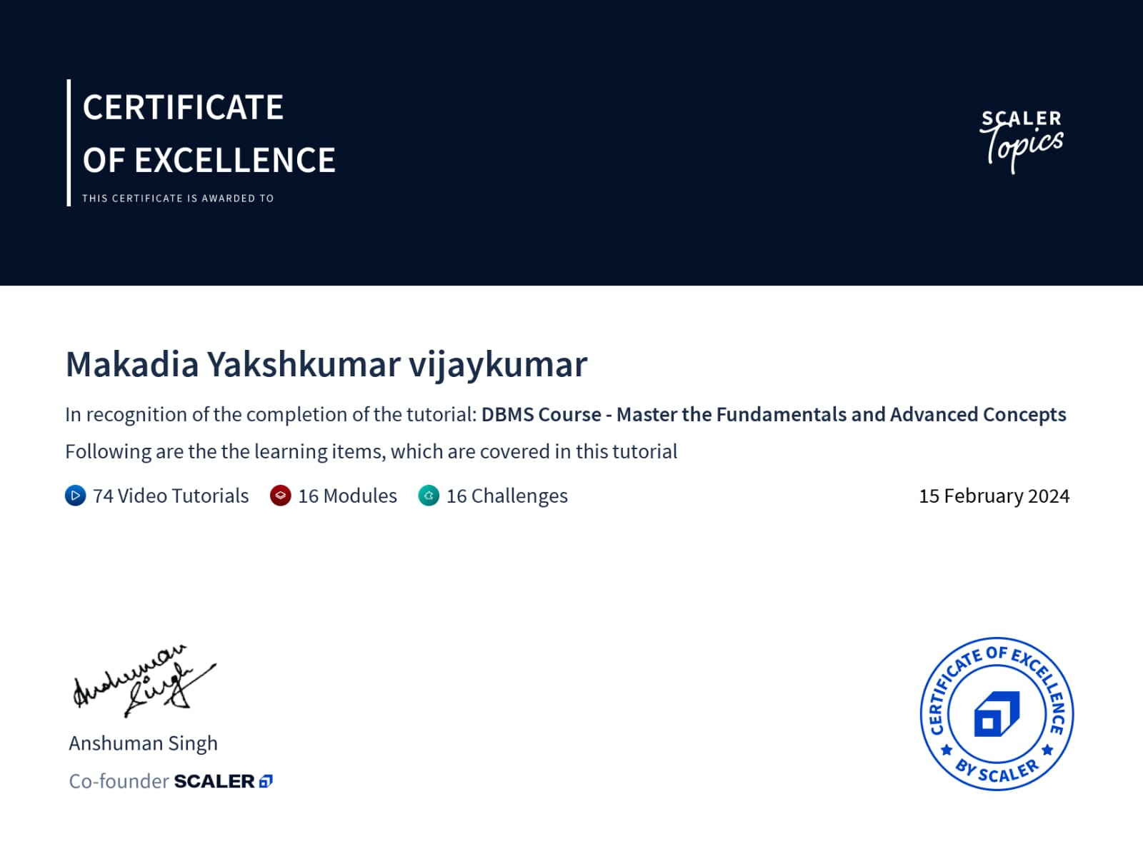
Online course certificate(RA2211003011035)

Slide 33
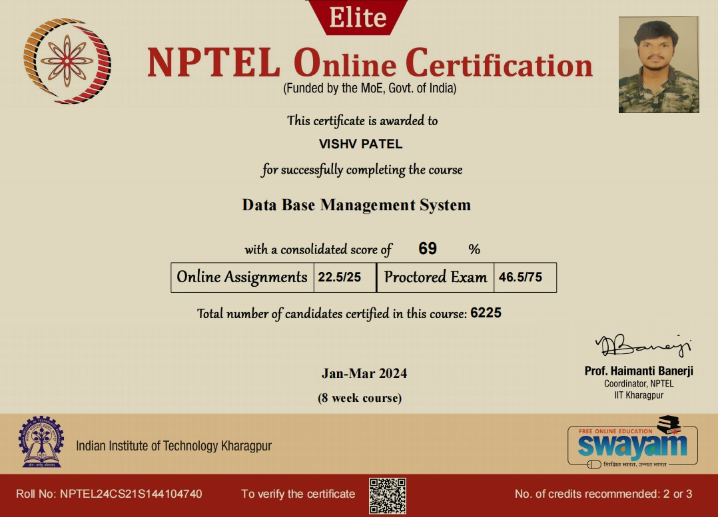
Online course certificate(RA2211003011063)

